Slide 1
Airbnb Price Prediction
Exploring patterns in airbnb dataset to understand the implications of different factors that affect the individual airbnb price
MIS 381N Final Project, Summer 2022

Slide 2
Traveling after summer classes?
Airbnb has revolutionized the travel industry with simple & convenient places to stay.
Hosts
How to list properties to generate additional income?
Travelers
What features should pay attention to find the optimally priced property?
Project Goals
Exploratory Data Analysis
Data Preprocessing
Modeling & Conclusion

Slide 3
Agenda
Project Goals
Exploratory Data Analysis
Data Preprocessing
Modeling & Conclusion
Project Goals
Exploratory Data Analysis
Data Preprocessing
Modeling & Conclusion

Slide 4
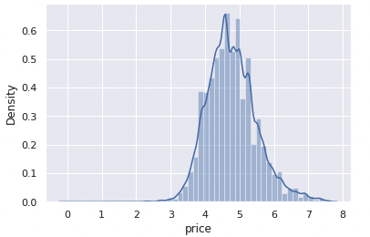
Data Description
Source: Kaggle (Dataset Here)
Number of Features: 29
Number of numerical features: 9
Number of categorical features: 18
Number of date features: 2
Target: log_price
The dataset consists of 74,111 records
Project Goals
Exploratory Data Analysis
Data Preprocessing
Modeling & Conclusion

Slide 5
Features
Property Feature
id
log_price
property_type
room_type
amenities
accommodates
bathrooms
bed_type
cleaning_fee
instant_bookable
bed
bedrooms
thumbnail_url
name
Rating/Review Feature
first_review
last_review
number_of_reviews
review_score_rating
Location Feature
city
description
latitude
longitude
neighbourhood
zipcode
Host-related Feature
cancellation_policy
host_has_profile_pic
host_identity_verified
host_response_rate
host_since
Project Goals
Exploratory Data Analysis
Data Preprocessing
Modeling & Conclusion
Notes:
Types of features present in the dataset – This can be divided broadly into 4 categories:
Property description: property_type, room_type, amenities, accommodates, bathrooms, bed_type, cleaning_fee, instant_bookable
Host features: cancellation_policy, host_has_profile_pic, host_identity_verified, host_response_rate, host_since
Location: city, description, latitude, longitude, neighbourhood, zipcode
Ratings and reviews: first_review, last_review, number_of_reviews, review_score_rating

Slide 6
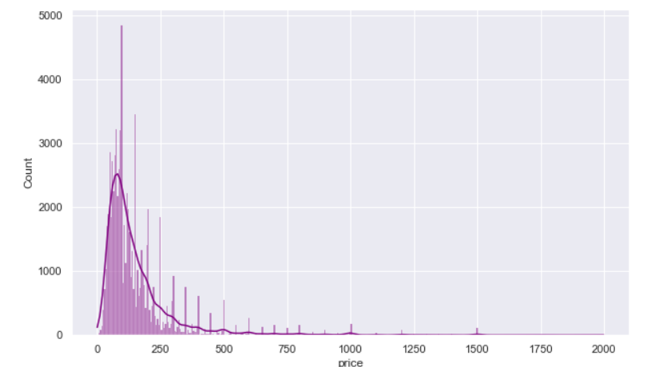
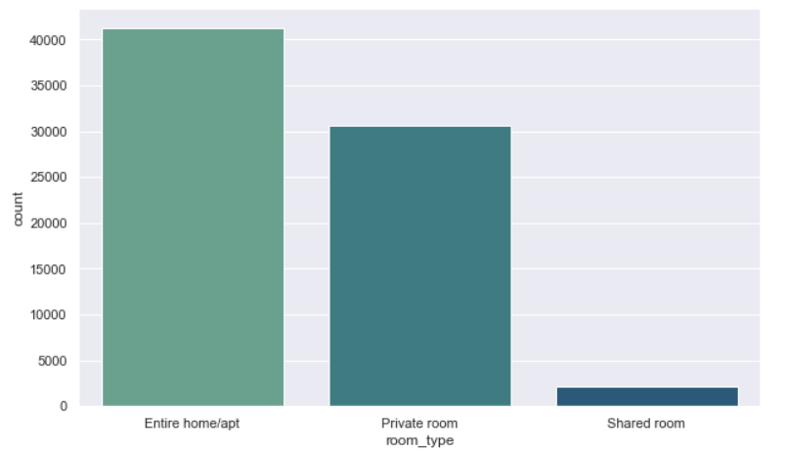
Exploratory Data Analysis
Only 3% of the listings are for shared rooms
97.2% have real beds
73.9% of the listings are in NYC and LA
Host response rate has a mean of 94.3%
~30% have a flexible cancellation policy
Review scores > 85
Project Goals
Exploratory Data Analysis
Data Preprocessing
Modeling & Conclusion

Slide 7
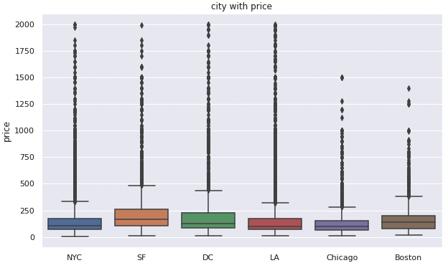
Exploratory Data Analysis
More expensive airbnb’s also have a stricter cancellation policy
Number of bedrooms and bathrooms have a significant impact on price
Host features seem to have a negligible effect on price
San Francisco has the highest avg number of ratings per airbnb, followed by Chicago
SF has the highest average median price of airbnb’s
NYC has the highest number of expensive neighborhoods followed by LA
Project Goals
Exploratory Data Analysis
Data Preprocessing
Modeling & Conclusion

Slide 8
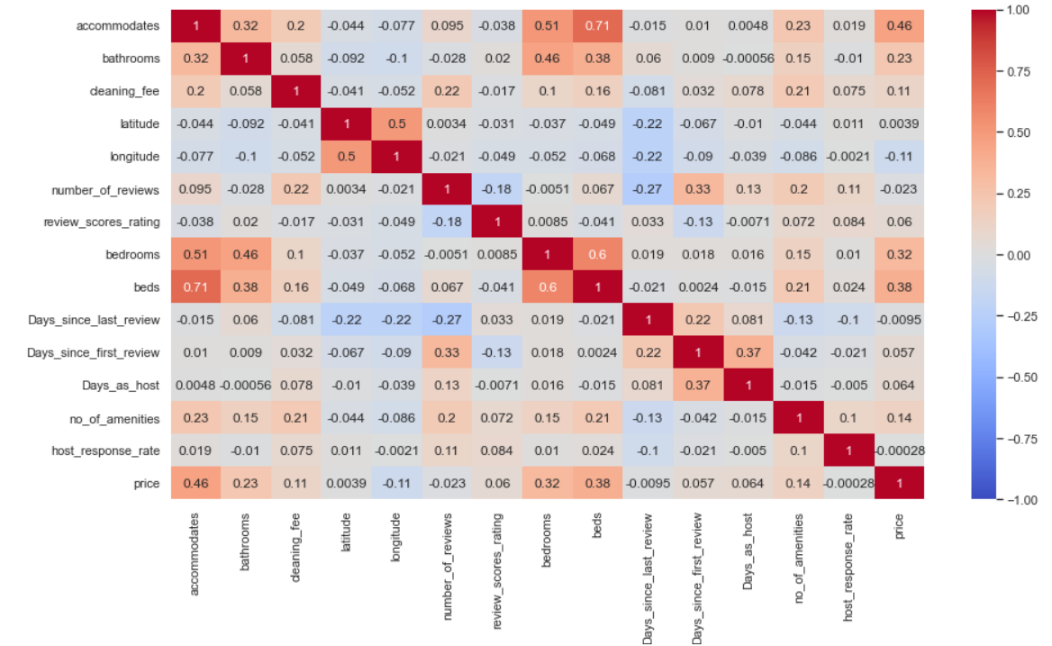
Correlation between variables
Number of people a room accommodates and bathrooms is correlated to the number of bedrooms
Cleaning fee has a positive correlation with number of amenities offered
Number of reviews is highly correlated with number of days elapsed since first review
Number of bedrooms has a correlation with price
Project Goals
Exploratory Data Analysis
Data Preprocessing
Modeling & Conclusion

Slide 9
Data Preprocessing
Drop Columns
Drop Null
Transform Variables
Split Train/Test
Dropped columns with no predicting power or duplicate usage
Encoding categorical variables and dates
Split the data into 80% training data and 20% testing data
Drop records with null values
Project Goals
Exploratory Data Analysis
Data Preprocessing
Modeling & Conclusion
Notes:
dropped name, id, description, latitude, longitude, neighbourhood, thumbnail url, zip code
no predicting power: name, id, thumbnail url, etc.
duplicate usage: zip code, latitude, longitude, etc.
dropped all records with null values
encoding categorical variables and dates:
amenities: count the number of amenities each airbnb provides
host response rate: meant to be numeric but recorded as strings; removed % and converted to int
first_review: change to number of days since the first review
host_since: same as first review

Slide 10
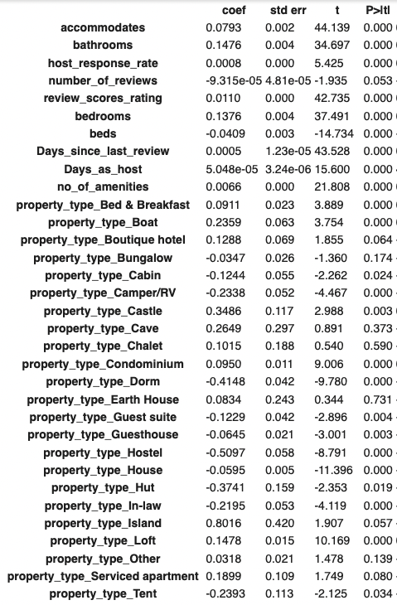
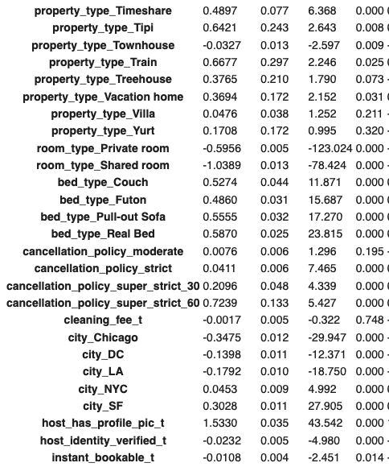
Linear Regression
Results Summary
RMSE | 0.4096
MAPE | 0.0672
R^2 | 0.63
We used all features to fit linear regression model
Features with p-value > 0.05:
number_of_reviews
property_type: boutique hotel, bungalow, cabin, cave, chalet, earth house, island, serviced apartment, treehouse, villa, yurt, other
cancellation_policy_moderate
cleaning_fee
Project Goals
Exploratory Data Analysis
Data Preprocessing
Modeling & Conclusion
Notes:
used all features

Slide 11
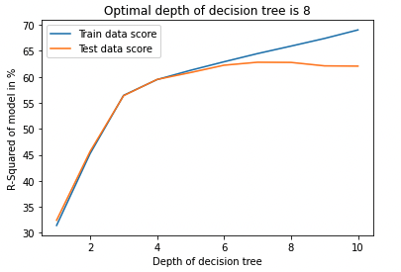
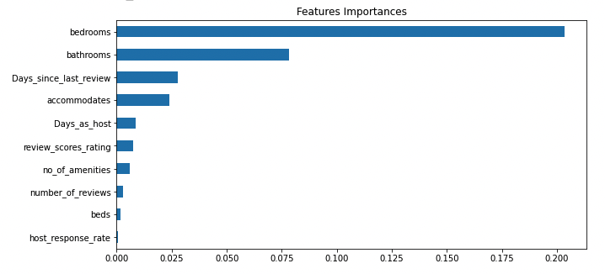
Decision Tree Regressor
Results Summary
RMSE | 0.1702
MAPE | 0.0674
R^2 | 0.63
Max depth of tree considered: 8
Top 5 most important features: bathrooms, bedrooms, number of days since last review, number of people that can be accommodated and number of days as host
Project Goals
Exploratory Data Analysis
Data Preprocessing
Modeling & Conclusion
Notes:
used all features

Slide 12
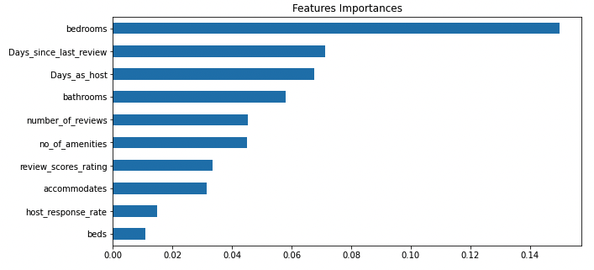
Random Forest
Results Summary
RMSE | 0.3880
MAPE | 0.063
R^2 | 0.67
Values of Parameters selected after tuning:
  n_estimators = 300
  max_depth=80
  random_state = 42
Project Goals
Exploratory Data Analysis
Data Preprocessing
Modeling & Conclusion
Notes:
used all features

Slide 13
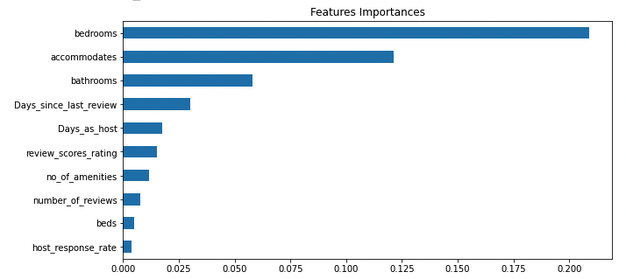
Gradient Boosting
Results Summary
RMSE | 0.3844
MAPE | 0.0631
R^2 | 0.68
Parameters tuned:
  n_estimators = 1000
  max_features = ‘auto’
Project Goals
Exploratory Data Analysis
Data Preprocessing
Modeling & Conclusion
Notes:
used all features

Slide 14
Model Performance & Output Comparison
 | Linear Regression | Decision Tree | Random Forest | Gradient Boosting
RMSE | 0.4096 | 0.1702 | 0.3880 | 0.3844
MAPE | 6.72% | 6.73% | 6.31% | 6.31%
R^2 | 0.63 | 0.63 | 0.67 | 0.68
Project Goals
Exploratory Data Analysis
Data Preprocessing
Modeling & Conclusion

Slide 15
Insights & Conclusion
Gradient Boosting yielded the best R-squared result, followed by Random Forest, Decision Tree, and OLS Linear Regression.
Overall, bedrooms, bathrooms, days_since_last_review and days_as_host are the top 4 features with the highest importances.
Project Goals
Exploratory Data Analysis
Data Preprocessing
Modeling & Conclusion
Notes:
From all the analysis done, we can sum up the factors that impact the price. As an Aspiring Airbnb host,should focus on above factors listed as important features to maximise the price of his listing. Also as a traveller who wants lowest possible price for listing might avoid these features in prospective housing

Slide 16
Thanks!
Any Questions?

